Slide 1
SAT grammar learning
By Theos Huang
2015.4.7

Slide 2

Curriculum Introduction
Overview of SAT
Improving Sentence （改进句子）
Identifying Sentence Error （改错）
Improving Paragraph（改进文章）
Practice of OG & the exam questions

Slide 3
Catalog for the Second Class
Ⅰ.Overview of the Sentence Grammar
Point 3 – 比较
Point 4 – 主谓一致
Ⅱ. Review
Ⅲ. Homework

Slide 4
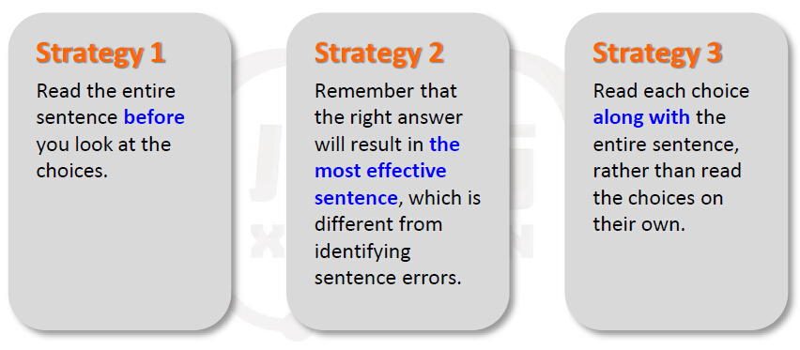
1.1 How to deal with the SAT Grammar

Slide 5
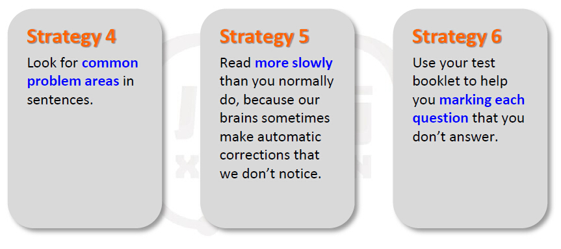
1.2 How to deal with the SAT Grammar

Slide 6
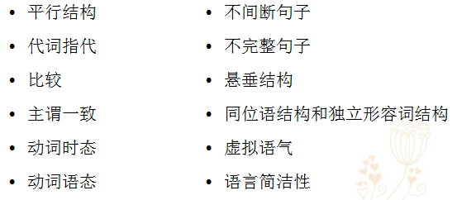
1.3 How to deal with Improving Sentence
Points

Slide 7
2. 1 Pre-test
Hockey fans in the 1990s saw more violence on the rink than the 1950s and 1960s.
A than
B than did
C than the hockey of
D than with the fans in
E than did fans in

Slide 8
2. 2 Improving Sentences: Point 1 ---比较
比较
英语中的同级比较用as...as (not as/so...as)表达，不同级比较使用more than结构，但SAT中关于比较的试题不限于此，大致可以归为以下几类:
1. 关于that of和those of的问题
2. 关于like/unlike/similar to/compared with/in comparison with的问题
3. 关于比较结构中补助动词的问题

Slide 9
2.2.1 关于that of和those of的问题
The title of this book is more interesting than that book.
典型错句，用the title和that book做比较，显然不对。正确的比较应该是：
The title of this book is more interesting than the title of that book.
把两本书的title进行比较，具有可比性，但为了避免重复，第二个the title要用that代替，句子的正确表达应该是：
The title of this book is more interesting than that of that book.

Slide 10
如果比较的对象是个复数概念，则第二个比较对象要用those而不是that来指代第一个比较对象。
The contents of this book are more interesting than those of that book.
在SAT有关比较的试题中，作比较的两部分一定要具有可比性。这是以汉语为母语的学生的一个难点。在表达比较时，汉语经常使用省略形式，但在SAT看来，这种省略就使比较对象之间缺乏可比性。
在比较对象为A of B的结构中，第二个比较对象在SAT中采用省略形式，所以在做题时，要找出具有that of / those of形式的句子部分。

Slide 11
2.2.2 关于like / unlike / similar to / compared with / in comparison with的问题
这五个单词或词组若在句中出现，就要首先考虑可比性的问题。
Like Mary, Judy’s Legs are also long.
句中划线部分显然不可比，应把Mary改为Mary’s (legs)。
在SAT的考题中，常常用上述五个词(组)开头，在其后加一个名词，而该名词的性质又和句子的主语不同，以此迷惑考生。
Compared with Tom, the works of Allen are more intelligent.
句子compared with后面的名词Tom为“人”，而句中的主语是“the works of Allen”，为“物”，两者显然不可比。
应把Tom改为those of Tom.

Slide 12
2.2.3 关于比较结构中补助动词的问题
在比较结构的第二部分中，主语后面常要补一个助动词，以使比较对象更加清楚。请比较：
I love Mary more than my parents.
I love Mary more than my parents do.
一般而言，当两个主语部分作比较时，SAT倾向于在第二个主语后加上助动词。
例外情况是第一个主语后没有宾语，如：
I run more quickly than you.
此句中只能是I和you作比较，不会产生歧义。

Slide 13
请看下列例句中补助动词的用法：
Yesterday I went to the cinema earlier than they did.
I do my homework better than Lily does.
They work harder than I do.
I can write better than you can.
She is studying SAT harder than I am.

Slide 14
值得注意的是，在SAT这一类考题中，当第二个主语过长时，常常把助动词放在第二个主语前。
The air outside has a higher concentration rate than does the air inside the room.
在此句中，由于第二个主语“the air inside the room”过长，故把该主语后的助动词does调到了主语前面。

Slide 15
2.3 Sample
Hockey fans in the 1990s saw more violence on the rink than the 1950s and 1960s.
A than
B than did
C than the hockey of
D than with the fans in
E than did fans in

Slide 16
2.4 Exercise 1
Unlike many female poets who preceded her, Emily Dickinson did not find her inspiration in light verse.
A Unlike many female poets who preceded her, Emily Dickinson
B Unlike the inspiration of many female poets who preceded her, Emily Dickinson
C Emily Dickinson’s poetry, Unlike many female poets who preceded her
D Different from many female poets who preceded her, Emily Dickinson’s poetry
E Emily Dickinson’s inspirations, different from many female poets who preceded her

Slide 17
2.5 Exercise 2
In the United States, the movement toward
neo-classicism was perhaps even more pronounced in architecture than either music or literature.
A either music or literature
B either music or in literature
C either in music or literature
D in either music or literature
E in either music or in literature

Slide 18
2.6 Exercise 3
Unlike a root canal, which is the preferred method for saving diseased tooth, chewing problems can result from an extraction.
A chewing problems can result from an extraction
B problems with chewing can result from an extraction
C an extraction is resulting in chewing problems
D an extraction can result in chewing problems
E an extraction resulting in chewing problems

Slide 19
2.7 Exercise 4
Psychologists believe that the way children acquire knowledge is no different for girls than boys.
A is no different for girls than boys
B are no different for girls than being boys
C is no different for girls than for boys
D are no different for girls than those who are boys
E are no different from those for girls than boys

Slide 20
2.8 Exercise 5
Some speedometers register high speeds as two hundred miles per hour, even though few cars will ever go faster than one hundred.
A high speeds as
B speeds as high as
C speeds that are high
D high speeds that are capable of exceeding
E a speed as

Slide 21
2.9 Exercise 6
The daily responsibilities of a law student are often as strenuous as a medical student.
A as a medical student
B as those of a medical student
C like a medical student
D such as a medical student
E like a medical student’s

Slide 22
2.10 Exercise 7
The bite pressure of wolves, harder than German Shepherds, is about 1,500 pounds per square inch.
A The bite pressure of wolves, harder than German Shepherds
B The bite pressure of wolves, which is harder than German Shepherds
C wolves’ bite pressure, harder than those of German Shepherds
D The bite pressure of wolves, harder than that of German Shepherds
E Harder than German Shepherds, the bite pressure of wolves

Slide 23
2.11 Exercise 8
If we compare the population of China with America over time, we see the Chinese population are increasing.
A If we compare the population of China with America over time, we see the Chinese population are
B Comparing the population of China with America, we see that the population of Chinese is
C In comparison with America, the population of China is
D To compare the population of China with America is to show that they are
E A comparison over time of the population of China and America shows that the population of China is

Slide 24
2.12 Exercise 9
Like most foreigners, the city’s local customs baffled the Greg for a few days.
A the city’s local customs baffled the Greg
B the local customs of the city baffling Greg
C Greg was baffled by the city’s local customs
D Greg, who found the city’s local customs baffling
E there were local customs in the city which confused Greg

Slide 25
2.13 Further questions （后测）
The coach chose Amanda to run the final lap of the relay, since her time was better than either Gwen or Christine.
A either Gwen or Christine
B either Gwen or else Christine
C either Gwen or that of Christine
D that of either Gwen or Christine
E either that of Gwen or that of Christine

Slide 26
3.1 Pre-test
One of the most frequently published and hardworking professors at the law school were available so frequently to launch with students that the faculty thought something was amiss with his research.
A were available so frequently to launch with students that the faculty thought something was
B was available so frequently to launch with students that the faculty thought something were
C was available so frequently to launch with students that the faculty thought something has gone
D was available so frequently to launch with students that the faculty thought something was
E was available so frequently to launch with students, so the faculty thought of it as something was

Slide 27
3. 2 Improving Sentences: Point 4 ---主谓一致
主谓一致
所谓主谓一致，是指句子的主语和谓语动词在数的方面保持一致：student ➔ is
students ➔ are
SAT通常把句子的主语和谓语动词之间用很长的干扰信息分隔开，这就要求考生必须能越过这些干扰迅速找到句子的主语和谓语部分，看看它们是否在数的方面保持了一致。
Mary, who is a pretty girl now studying with her many classmates, are from China.

Slide 28
◆ 难 点
虽然英文中有些名词看上去是复数，但谓语动词要用单数；而有些名词看上去是单数，谓语动词却要用复数形式。
有些名词在表达不同意思时，谓语动词要根据其意思采用单数或复数形式，此处SAT可能只会考到一下知识点：
More than one student is …
More students than one are …
Many a student is …
Many students are …
Many a student and teacher is …
One student or two is …
A writer and translator is …
A writer and a translator are …

Slide 29
在either A or B，not only A but also B，neither A nor B结构中，谓语动词采用单数或复数取决于B：
Not only Mary but also her friends are from China.
但在下列结构中，谓语动词的单复数形式取决于A：
A, with B, A, together with B,
A, rather than B, A, as well as B,
A, in addition to B,
★ a number of / an average of / a total of后面加复数名词，动词用复数形式；但the number of / the average of / the total of后面加复数名词，而动词用单数形式：
A number of students are playing in the square.
The number of students playing on the ground is fourteen.

Slide 30
SAT经常出的一个考题是：
one of those students who are …
the only one of those students who is …
就是说，如果one前面被the only修饰的话，who是指代one的，而不是students。

Slide 31
Attention！！
要特别注意下面的名词，意思不同时，数也不同：
Statistics are misleading. （统计数据）
Statistics is an interesting subject. （统计学）
Acoustics in the hall are good. （声响效果）
Acoustics is a hard subject. （声学）
一个复数名词后有each时，谓语动词依然是复数形式：
The students each have his own interest.
但each做主语时，谓语动词用单数：
Each of the students has a book.

Slide 32
3.3 Sample
One of the most frequently published and hardworking professors at the law school were available so frequently to launch with students that the faculty thought something was amiss with his research.
A were available so frequently to launch with students that the faculty thought something was
B was available so frequently to launch with students that the faculty thought something were
C was available so frequently to launch with students that the faculty thought something has gone
D was available so frequently to launch with students that the faculty thought something was
E was available so frequently to launch with students, so the faculty thought of it as something was

Slide 33
3.4 Exercise 1
Last month, one of my best friends were absent so often that I was afraid she might be seriously ill.
A were absent so often that I was afraid she might be
B were absent so often that I were afraid she might be
C were absent so often; that I was afraid she might be
D was absent so often that I was afraid she might be
E was absent so often; that I was afraid she might be

Slide 34
3.5 Exercise 2
For days, one of the Olympic favorites were swimming so slowly that her coaches thought she was hurt.
A were swimming so slowly that her coaches thought she was
B was swimming so slowly that her coaches thought something were
C were swimming so slowly; so her coaches thought something has been
D was swimming so slowly that her coaches thought she was
E was swimming so slowly; so her coaches thought of it as

Slide 35
3.6 Further questions （后测）
The negative consequences of eating fast food often is increasingly discussed in the media.
A is increasingly discussed in the media
B is more and more discussed in the media
C are increasingly discussed in the media
D are increasingly in discussion in the media
E has increased in discussion in the media

Slide 36
Ⅱ. Review
SAT 的介绍（一共几个考试部分，每个考试部分的分数，题目分配）
SAT 语法题的介绍（题型，语法题应该怎样分析）
两个语法点：比较、主谓一致

Slide 37
Ⅲ. Homework
做OG Practice Test 中有比较、主谓一致的语法题。

